Slide 1


Experiences, not Apps:
Microfrontends and their BFFs
Colin Young
9/27/23

Slide 2



$ whoami
Consultant, 2015
Engineering Mgr, 2021
Software Eng, 2023

Slide 3
Backend first

Slide 4
Most teams that use microservices mostly just use them on the backend.
Increase agility, decrease release times, and improve separation of concerns.
Challenges: discoverability, documentation, enforced contracts, testing, and of course, more.
Not perfect for all teams

Slide 5

Microservice transformations…
you hate to see it
How to break the monolith
Identify domains
Separate data
Identify dependencies
Make APIs
https://insights.sei.cmu.edu/blog/8-steps-for-migrating-existing-applications-to-microservices/
Martin Fowler

Slide 6
Microfrontends are microservices too.
Separates concerns (into experiences)
Clearly library vs. UI code
Can be released separately(!)
Optimize bundle size rather than giant artifacts

Slide 7
How to start
Define your Jobs To Be Done .
Take, for example, a lending company’s monolithic React app fed by microservices.
Loan
Applicants
Estimate Your Payment
Apply for Credit
Service Payments
Sign Your Loan
Learn how to Embed Your Credit App
Customize their Co-Branding
Lead Gen
Partners
See Referral Stats
Do Standard SaaS Stuff
Notes:
This pattern might apply to a lot of SaaS business like insurance, e-commerce, payments, etc.
https://jobs-to-be-done.com/jobs-to-be-done-a-framework-for-customer-needs-c883cbf61c90

Slide 8
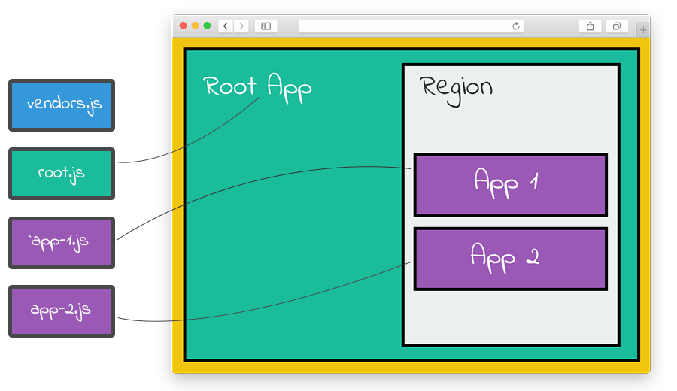
Libraries
The NKOTB:
Frint.js
The Stalwart: Single-SPA
The Minimalist: RYO

Slide 9
Networking
Introduce your micros to their BFFs

Slide 10
Migrating to microfrontends
Build on the shoulders of giants first
react-microfrontends
Two types of separate apps
Common components
JTBDs with disparate business logic
Don’t import the same thing twice
Import Maps
Tree shaking
Divide microfrontends in a complementary way to microservices
Domain-based
If it ain’t a perfect match, introduce BFFs
Notes:
Common components - chrome
Miniapps - often on their own route. Often only used by one user type.

Slide 11
Quick review
JTBDs. Lending app. Got it.
Loan
Applicants
Estimate
Apply
Sign
Lead Gen
Partners
Embed
Customize
Measure
Notes:
This pattern might apply to a lot of SaaS business like insurance, e-commerce, payments, etc.
https://jobs-to-be-done.com/jobs-to-be-done-a-framework-for-customer-needs-c883cbf61c90

Slide 12
Map your micros
Your Giant React App
User App
Partner App
User Experiences
User Experiences
<ApplyForCredit />
/bff/* ➡ //yourapi.com/apply-for-credit/
<ApplyForCredit />
/bff/* ➡ //yourapi.com/apply-for-credit/
<ApplyForCredit />
/bff/* ➡ //yourapi.com/apply-for-credit/
<HelpMeIntegrate />
/bff/* ➡ //yourapi.com/integrations/
Notes:
Obviously bigger than just this

Slide 13
Backends-for-frontends
Sam Newman
Small and fast
Run wherever you want, but make it simple
Can do the dirty work of hitting multiple services
Basically serve two purposes:
Provide UI-driven types/schema
Safety when things change
Just like other microservices, they can be released separately and contract-tested

Slide 14
BFF layout
The microservice
https://api.yourco.com/
v1/loan-applications
The BFF
https://api.yourco.com/bffs/apply-for-credit/*
The experience
https://js.yourco.com/
apply-for-credit.min.js

Slide 15
Bringing everyone together
Your team, too

Slide 16
Put simply
1
2
3
4
5
Now…
Identify shared chrome
Define experiences using jobs-to-be-done
Come up with schemas using product requirements
Make BFFs for experiences (figure out services they hit)
Setup release pipelines and testing
Frontend can build UI without waiting on anybody
Backend knows they won’t break anything
You can actually continuously deploy for the first time in your life

Slide 17
That’s nice, but
How do I actually do it?

Slide 18
Demo

Slide 19
Going steady
Delete the app

Slide 20
What do you get out of this relationship?
BE-driven schemas
Gotta build dependencies
Stateful
Huge regressions
Single pipeline
Single surface
UI-driven schemas
Shared types
Stateless
Ship separately
Multiple pipelines
Any surface

Slide 21
Tips to succeed
Sam Newman
Get product folks to be advocates
Get buy-in from devops, backend, and QA
Use something like Storybook or the NKOTB, Ladle
Implement contract testing (e.g. Pact)

Slide 22
Gotchas
Nobody’s perfect

Slide 23
Gotchas
BFF RBAC
One mitigation: detailed JWTs
Session
KISS
Time-to-market
Don’t be a tiny startup
Backend-team adaptation
Get frontend involved
CSS
Make sure to reset and namespace

Slide 24
Thank you!
Resources below
Single SPA
Utility microfrontends
Module federation and System.import
Code-splitting

